Slide 1






TEACING PLATFORM FOR LEARNING BY VOICE CONTROL
1
TRAVEL-WITH-US
APPLICATION
SUPERVISOR:
PRESENTED BY:
MOSHE SULAMY
PELEG OANUNO
RON LAHIANI

Slide 2


Introduction: The Problem
2
Traditional language learning methods are often ineffective and dull.
relying on rote memorization.
Learners struggle to apply language skills in real-life scenarios, such as navigating foreign environments.
There is a need for more interactive, practical approaches to language learning, especially for travelers​.

Slide 3



3
Proposed Solution:
Development of TravelWithUs, an innovative Unity-based app for travelers.
Utilizes Google Cloud Speech-to-Text for real-time voice recognition.
Provides contextual learning through immersive scenarios that allow users to practice language in meaningful, practical contexts.

Slide 4





System Requirements
4
Voice Recognition Accuracy
Real-time Feedback
Advanced speech recognition capable of handling multiple accents.
Instant responses to improve language skills.
Interactive Scenarios
Progress Tracking
Simulate real-life situations.
User progress through points and levels.

Slide 5





Technologies and Tools:
5
Unity Engine:
Google Cloud Speech-to-Text
Used to build an interactive 2D environment for the game.
Provides real-time voice recognition for language practice.
Firebase
GitHub
Handles user progress tracking and securely stores data in the cloud.
Used for version control to manage development efficiently.

Slide 6


Project Goals:
6
Revolutionize language learning with an engaging and practical approach.
Make language learning enjoyable and accessible to all.
Bridge the gap between theoretical knowledge and practical language use.
Enhance cultural awareness and sensitivity.
Utilize technology and gamification for more effective learning.

Slide 7
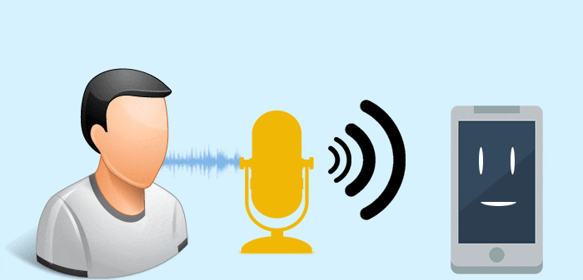
Challenges and Solutions:
7
1.Voice Recognition Integration: We faced challenges with integrating Google’s Speech-to-Text API, especially with response time.
2.Voice Recognition Accurancy: Achieving high accuracy in recognizing diverse accents, tones, and speech patterns poses a significant challenge.

Slide 8


Challenges and Solutions:
8
3.Language Handling: Implementing both English and Spanish.
4.Real-time Processing: Ensuring that voice inputs are processed promptly to provide immediate feedback without noticeable delays.

Slide 9
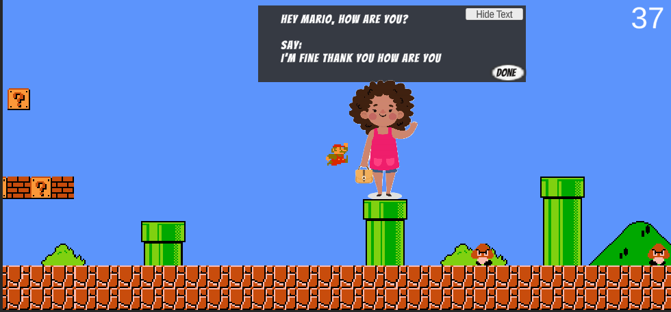

Game Features:
9
Supporting more than one language:
English:
Spanish:

Slide 10


Game Features:
10
2. Accuracy mesasurment:
In our game, the accuracy of speech recognition is measured using an algorithm that evaluates how many words the user pronounced correctly compared to the expected sentence.

Slide 11

Game Features:
11
2. Real-life situations for travelers
In our game, we designed various real-life situations that travelers commonly face to make the learning experience practical and engaging.

Slide 12


Game Features:
12
3. Cloud
To enhance the user experience, we implemented cloud storage to keep track of each user's score and progress.

Slide 13

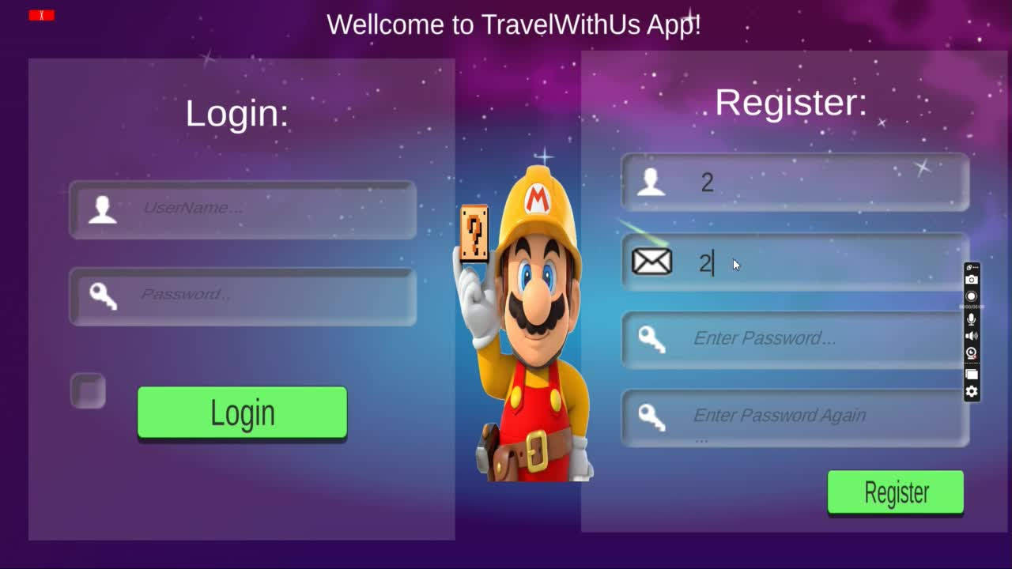
Demonstration
13
Example:

Slide 14

14
Verification
To validate our system, we conducted two types of evaluation tests:
Unit testing
Functional testing.

Slide 15
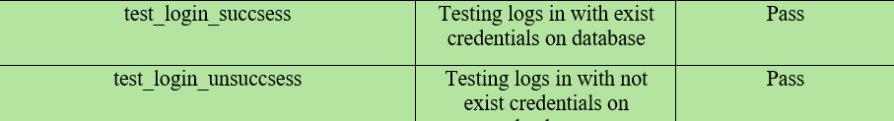


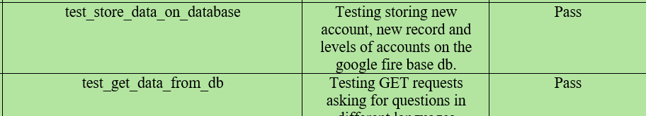

Unit testing
15

Slide 16
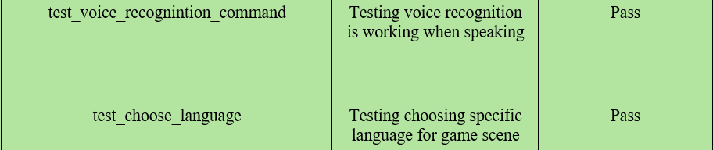




Functional testing
16

Slide 17



17
Conclusion
The integration of Google Speech-to-Text.
Speech recognition with real-life travel scenarios.
Cloud Storage
Future Improvements

Slide 18



Thank you for your attention

